Slide 1

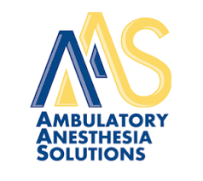
Investment Memorandum
Ambulatory Anesthesia Solutions, LLC
(“AAS”)
November 2025
Confidential

Slide 2
Index
Executive Summary
Company Overview
Valuation Summary & Model Outputs
Key Risks & Mitigants
Sector Overview – Anesthesia and ASCs
Financing Status Update
Legal Update
Due Diligence Updates

Slide 3
Timeline & Diligence Update
Date of Signed LOI: 6/2/2025
Days Since LOI Signing: 146 (as of 10/26/2025)
Proposed Close Date: 11/7/2025

Slide 4
Executive Summary
I

Slide 5
Executive Summary
The Opportunity
Ambulatory Anesthesia Solutions (“AAS” or the “Company”) provides anesthesia staffing, billing, and operational support to Ambulatory Surgery Centers (“ASCs”) in Michigan and Indiana under long-term evergreen contracts.
The outpatient surgery market is experiencing robust growth, driven by patient preference, cost efficiency, and payer trends shifting procedures away from hospitals. At the same time, a worsening national shortage of anesthesia providers has created a structural supply-demand imbalance. AAS has a proven ability to recruit and retain talent, offering a compelling value proposition to ASCs and providers alike.
With Northern Shore’s resources and operational expertise, AAS is positioned to rapidly accelerate growth by expanding contract wins, professionalizing its infrastructure, and enhancing profitability.
Company Snapshot
Operations: Provides anesthesia staffing (CRNAs & MDAs), billing, and operational support exclusively to ASCs (no hospital exposure).
Ownership: Co-founders Chris Youst (CEO) and Mark Nold (COO) lead the business and will reinvest a significant portion of their equity proceeds. A third shareholder (33% of Michigan entity) will be fully bought out at close.
Headquarters: Troy, Michigan
Competitive Advantages: Strong recruitment/retention despite industry shortages, supported by attractive ambulatory work-life balance. Flexible PRN staffing model enabling quick ramp-up of new contracts. Long-term evergreen contracts providing predictable revenue.
Capitalization & Transaction
LOI: signed on June 2, 2025, with an anticipated closing by October 31, 2025.
Process: Run by Greenwich Capital Group, with whom Northern Shore has a long-standing relationship.
Valuation: 7.9x ($34 million).
Seller Dynamics: Co-Founders remain highly committed post-close, rolling equity alongside Northern Shore and continuing to run the business day-to-day.
Earnout/Multiple buydown: The transaction includes an earnout of 1.0x ($4.5M), which, if paid, would bring total cash consideration to $38.5M. This structure incentivizes growth while also reducing our effective acquisition multiple if the earnout is achieved.
Northern Shore Advantage
Deep Sector Expertise: Proven track record scaling founder-led healthcare businesses, highlighted by Scott Barry’s leadership at Centria Healthcare. NSC brings to bear repeatable value creation playbooks with demonstrated success in both organic expansion and add-on acquisitions in fragmented healthcare niches.
Founder-Friendly Approach: AAS selected Northern Shore as its preferred partner despite broad buyer interest. There is alignment with management’s growth vision and cultural fit as a Michigan-based partner.
Strategic Resources: Ability to fund accelerated ASC contract growth and professionalize infrastructure (e.g. bringing billing & collections in-house, CFO, recruiting, etc.).
Attractive Exit Opportunity
Provider of Choice in Labor-Constrained Market: Serving as a trusted partner to ASCs in an environment of provider shortages, AAS is uniquely positioned to continue capturing market share and will represent a scarce, highly defensible asset at exit.
Proven De Novo Growth: AAS has a demonstrated ability to enter new markets, and when combined with a strategic focus on higher-reimbursement geographies that provide a clear path to margin expansion and enhanced profitability, there is a clear path to $10 million + EBITDA.
Multiple Expansion Potential: While not underwritten to, building a professionalized, scaled anesthesia staffing provider should garner significant buyer interest from both private equity and strategics, creating potential to trade at a significant premium to our purchase multiple and more in-line with that of traditional healthcare services platforms.

Slide 6
Executive Summary (cont’d)
Deal Source / Process Details
Company Overview
The process is being run by Greenwich Capital Group out of their Birmingham, Michigan office.
Northern Shore signed an LOI on June 2nd, 2025.
Our LOI values the business at $34.0M (7.9x) cash at close plus a contingent $4.5M earnout based on aggressive future growth targets. If hit, our effective entry multiple would decrease given the growth in EBITDA required to pay the earnouts.
NSC would fund an incremental $5.0 million of cash to the balance sheet to fund SG&A investments and growth of new ASC contracts.
NSC’s investment thesis, sector focus, and experience aligns well with AAS’s ownership and business model.
AAS Michigan was founded in 2009. AAS Indiana was founded in 2022. AAS provides anesthesia staffing (CRNAs & MDAs), billing, and operational support to Ambulatory Surgery Centers (ASCs) in Michigan and Indiana through long-term contracts.
Fee-for-service income is ~20% of overall income (direct payments from ASCs).
Collection-based income & true-up contracts: ~80% (insurance reimbursements + contractual minimums with ASCs).
Investment Highlights & Key Considerations
Employer of choice – ASC-only focus creates ability to recruit and retain talent better than competitors, enabling AAS to capture share; In a labor-constrained industry, differentiated recruiting and retention position the Company as a scarce and highly-attractive asset.
Contracted & recurring revenue model with downside protection – multi-year contracts with built-in labor floors provide predictable, de-risked cash flow and reduce revenue volatility while providing upside opportunity through improved revenue cycle performance.
Strong pipeline of new ASC partnerships in Indiana and Michigan with a model that can easily be replicated in new geographies.
Opportunity to build density in existing markets and expand into new geographies with stronger reimbursement dynamics.
Led by strong operators with currently limited bandwidth which can be unlocked with Northern Shore’s resources and operational expertise.
Customer Concentration – Significant revenue exposure to IU Health contracts; while evergreen in structure with discrete contracts per ASC, concentration is not without risk.
Limited Infrastructure & Playbooks – current operations rely heavily on ad hoc processes without standardized systems or formal playbooks; presents both a challenge and a value-creation opportunity through Northern Shore’s implementation of best practices.
Young Management Team – Founders have successfully scaled the business to-date but lack experience operating at larger scale; Northern Shore will provide support with infrastructure, professional management, and oversight to support growth.
Transaction Overview / Ownership Structure
The business is legally split into two entities for Michigan and Indiana. The Michigan business is owned 33.3% each by co-founders Chris Youst (CEO), Mark Nold (COO), and Mike Bernard (Medical Practice Director). The Indiana business is owned 50/50 by Chris and Mark.
Chris and Mark and excited to roll equity and continue running the business post-close.
We anticipate financing the transaction with a modest amount of leverage at close (currently assumed to be 3.5x) along with management rollover and equity from Northern Shore.
Valuation Summary
Our LOI valuation is $34 million cash at close, based on July 2025 TTM EBITDA of $4.3 million. This represents a TEV of $34.0 million plus a contingent earnout of $4.5 million. The NSC equity requirement at this valuation is $15.0 million.

Slide 7






A Scalable Solution to a Growing Supply-Demand Imbalance
AAS is winning in a labor-constrained market by solving a pain-point other providers haven’t.
Employer of Choice |  | AAS is the employer of choice in a market facing a severe and worsening shortage of Nurse Anesthetists (“CRNAs”) and Anesthesiologists (“MDAs”) – AAS’s clinician-first model enables recruitment and retention where others struggle. AAS is focused exclusively on Ambulatory Surgical Centers (“ASCs”), which enables a superior work-life balance for providers: no nights, weekends, or call shifts. In a specialty plagued by burnout, this matters.
Focused Exclusively on ASCs
Large, Flexible Staffing Model |  | AAS operates with a large and flexible staffing model allowing efficient scheduling and scaling with the ability to meet new demand quickly – a key advantage as ASC volume continues to rise.
Positioned to Scale |  | Unique model for aggregating a usable labor pool that is well-positioned to scale faster with Northern Shore’s resources and expertise, with the ability to enter new markets at a much more rapid pace than they have historically (e.g., the Indiana expansion in 2022).
Opportunity to Capitalize on Market Shift |  | ASCs and hospitals increasingly view anesthesia as a cost center, AAS is positioned to capitalize with a unique staffing model and pricing structure that lowers costs and complexity for ASCs while preserving strong margins and downside protection.
Platform for Expansion and Improved Profitability |  | AAS is a scalable platform designed to expand into new geographies while also deepening density in current markets, driving improved reimbursement and Revenue Cycle Management (“RCM”) performance.

Slide 8
AAS Investment Thesis
Aging population
Increasing number of surgeries
Increasing demand for anesthesia services
Shortage of MDA and CRNAs expected to increase over next ten years
Shift towards value-based care
Technological advancements
Shift towards moving surgeries to outpatient settings
Growth in ASC market
Highly fragmented ASC market
Highly fragmented outsourced anesthesia market
Fragmented market creates opportunity for new contract wins, along with acquisitions in current and new geographies
AAS is well positioned to capitalize on converging secular tailwinds by capturing new ASC contracts in a highly fragmented market, driving sustained organic growth over the next 5+ years.

Slide 9
Company Overview
II

Slide 10
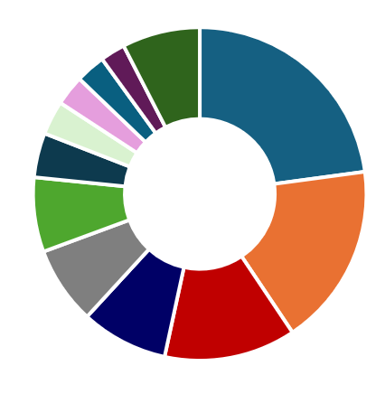
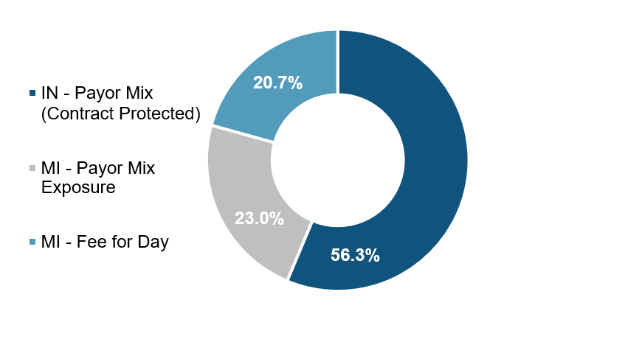
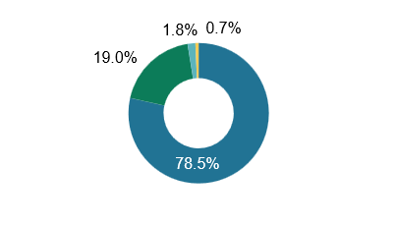
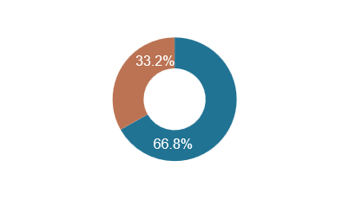
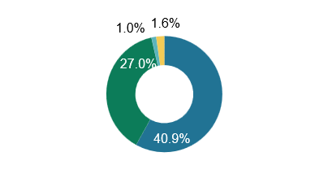
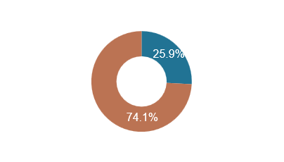
Company Overview
Payor Mix
Procedure Mix
Sales Mix: Limited Payor Mix Exposure
Ophthalmologic | 22.9%
Orthopedic | 17.7%
Neuromuscular | 12.8%
Endoscopic | 8.4%
Gastrointestinal | 7.5%
Pain Management | 7.2%
Image-Guided | 4.3%
ENT | 3.3%
Neurosurgical | 2.9%
Abdominal | 2.9%
Dental / Oral Surgery | 2.4%
Miscellaneous / Other | 7.6%
Only 23% of AAS revenue is directly tied to potential payor risk
*Sales as of TTM Aug-2024
2022 - TTM Aug-2024 Payor Mix
Growth Opportunities
Overall Payor Mix
Commercial Payor Mix
Expand ASC Partnerships – AAS has a strong pipeline of new Ambulatory Surgery Centers (ASCs), particularly in Indiana and Michigan, where management is actively pursuing additional contracts​.
Deeper Penetration into IU Health – AAS currently serves 7 of IU Health’s 17 ASCs. Successfully scaling operations within IU Health could significantly increase revenue​.
Geographic Expansion – The company’s scalable staffing model allows it to expand beyond its current Michigan and Indiana footprint into other states with superior reimbursement rates.
Increased Collections + Labor Floor Contracts – Shifting more ASCs to a billing & collections model with a labor floor provides downside protection with potential for outsized margins to the extent AAS can collect above the floor.
Michigan
Indiana
Commercial
Workers Comp
Commercial (BCBS)
Government
Self Pay
Commercial (Others)

Slide 11
Company Overview (cont’d)
Business Unit Comparison
Factor | AAS Michigan | AAS Indiana
Market Entry | Founded in 2009 | Expanded into in 2022
Revenue / EBITDA (2025E)* | $12.3M / $1.7M (13.8%) | $15.7M / $2.9M (18.5%)
FY 2025 Customer Base | 16 ASCs, diversified partnerships | 13 ASCs, concentrated in IU Health
Employees (est.) | 16 MDAs / 110 CRNAs | 36 MDAs / 37 CRNAs
Revenue Model | Mix of fee-for-service and collections-based income | Guaranteed minimum payments via true-up contracts
Contract Structure | Some fee-for-day arrangements, others dependent on insurance reimbursements | 3- to 5-year ASC contracts with locked-in labor costs and annual escalators
Payor Risk | Higher payor risk due to reliance on insurance collections | Lower payor risk since ASCs must cover labor costs, regardless of collections
Anesthesia Model | Traditional MDA/CRNA staffing model | Introduced CRNA model to IU Health (previously MDA-only)
*Company projections, exclude NSC Corporate Overhead costs

Slide 12
Employee Overview
Employee Overview
Clinical Staff Overview
Previously, all full-time and part-time employees were structured as 1099 independent contractors, including both providers (MDAs, CRNAs) as well as back-office and administrative staff.
The Company has since fully completed its conversion of full-time and part-time 1099 staff to W2, with remaining PRN staying 1099
AAS’s clinical staff is composed of highly skilled anesthesiologists and CRNAs, committed to providing top-tier patient care.
Clinical staff includes a dedicated Clinical Lead attached to each ASC to ensure the highest standards are upheld.
AAS employs a tiered payment structure and bonus for its clinical staff, with employment options including full-time, part-time, and as needed staff (PRNs).
Clinical staff is equipped to handle a wide range of ambulatory procedures across a variety of specialties.
AAS prides itself on enabling favorable work-life balance for its contractors, as the healthcare industry experiences a collective burnout.
Clinical staff maintains up-to-date credentialing, trained on various platforms including EPIC, among others.
AAS Michigan
AAS Indiana
Physicians (16)
Physicians (36)
Full-Time (4)
Full-Time (17)
Part-Time (1)
Part-Time (1)
PRN* (11)
PRN* (18)
CRNA’s (110)
CRNA’s (37)
Office Staff Overview
Full-Time (5)
Full-Time (6)
AAS maintains a lean back-office function of 5 employees in a fully-remote work environment. Investment in back-office will be critical to achieve growth.
Office staff are eligible for performance-based bonuses.
AAS Indiana maintains a shared services agreement with AAS in which it utilizes Michigan’s office staff. For all intents and purposes, it operates as one back office for both Michigan and Indiana.
Part-Time (4)
Part-Time (2)
PRN* (101)
PRN* (29)
Office Staff (5)
Office Staff (5)
Shared Service Agreement
Staff: | 131
ASC’s: | 12
Staff: | 78
ASC’s: | 8
*As needed staff

Slide 13
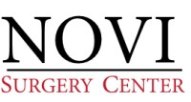


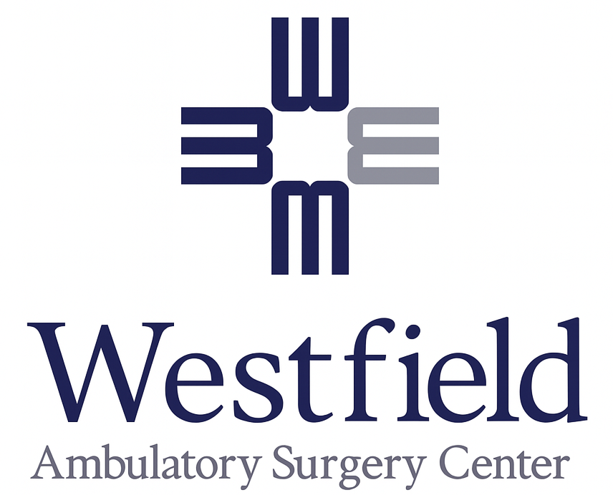


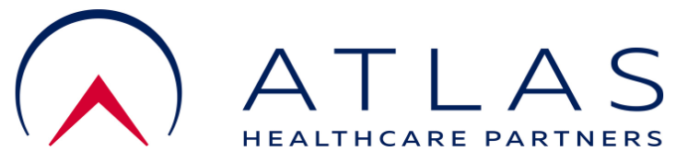
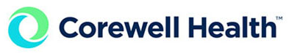
Key ASC Wins Driving Growth
AAS has executed multiple new ASC contracts with several others set to start between November 2025 – March 2026, representing over $13 million of incremental revenue
ASC | State | Contract Status | Operational Date | # of Monthly CRNA FTEs | CRNA Labor Floor | # of Monthly MDA FTEs | MDA Labor Floor | Mgmt. Fee | 2026 Annual Revenue | Anticipated Gross Profit
 |  | In Process | Nov-2025 (Anticipated Expansion Timing) | 4.6 | $1,450 | 2.1 | $2,725 | - | $3.0M | $794.2K
 |  | Executed | Sept-2025 | 5.0 | $1,450 | 2.0 | $2,725 | - | $2.8M | $754.0K
 |  | Executed | Dec-2025 | - | - | 5.0 | $2,906 | ✓ | $4.4M | $1.5M
 |  | Executed | Aug-2025 | 0.3 | $1,904 | 1.2 | $2,906 | ✓ | $1.2M | $411.8K
 |  | In Process | Nov-2025 | 0.3 | $2,000 | 1.0 | $3,200 | ✓ | $1.1M | $437.0K
 |  | In Process | Jan-2026 | 0.3 | $1,530 | 0.6 | $2,738 | - | $348.0K | $88.0K
 |  | In Process | Mar-2026 | 0.3 | $1,887 | 0.3 | $2,828 | ✓ | $326.0K | $108.0K
Utica
Troy
Indianapolis
Greenwood
Lafeyette
Evansville
Riverview De Novo

Slide 14

Near-Term Opportunity Pipeline
The Company is in active discussions with several new ASC customers that are expected to convert into signed contracts, adding significant upside to the projections included herein.
ASC | State | # of Monthly CRNA FTEs | CRNA Labor Floor | # of Monthly MDA FTEs | MDA Labor Floor | Mgmt. Fee | Revenue Opportunity
 |  | 1.5 | $1,450 | 1 | $2,725 | - | $1.2M
 |  | 4 | $1,450 | 1 | $2,725 | - | $2.1M
 |  | 4 | $1,887 | 2 | $2,828 | ✓ | $3.0M - $3.5M
Ortho-center
Flint
Grand Rapids
Springmill Surgery Center

Slide 15
Overview of Contract Types
Pure Billing & Collections
1 ASC
14% of 2024 Revenue
Legacy revenue model. New ASCs will be either fee for service or include a labor floor (or management fee).
Contracts are 1-3 years in length and are regularly renegotiated to adjust for increases in labor costs.
Fee for Service
8 ASCs
22% of 2024 Revenue
Contracts are 1-3 years in length and are regularly renegotiated to adjust for increases in labor costs.
Billing & Collections + Labor Floor
7 ASCs
5% of 2024 Revenue
Contracts are 1-3 years in length and are regularly renegotiated to adjust for increases in labor costs.
True-Up Mechanism + Management Fee
13 ASCs
59% of 2024 Revenue
Contracts are 3-5 years with automatic renewal terms
A monthly true-up process occurs to ensure payment if collections fall short of combined labor cost and management fees.
Labor costs for CRNAs are contractually fixed annually and increase by a minimum of 3% annually.

Slide 16
ASC Contract Overview
By the end of 2025, the Company will be actively operating at 29 ASC locations across Michigan and Indiana.
Contract terms range from 1 – 5 years and typically auto-renew unless cancelled by AAS or the customer.
The Company has terminated contracts in the past (typically these have been pure billing & collections contracts from the pre-Auto No Fault reform era), but has never lost a contract driven by the ASC.

Slide 17
2026 Contracts Up for Renewal
The Company has seven contracts up for renewal in 2026, representing 24.6% of total 2026 forecasted revenue.
As noted in the table below, five of the seven contracts up for renewal in 2026 are 1-year recurring contracts, which have all renewed annually since their original signings between March 2020 and May 2024.
Of the Company’s 26 signed contracts, only the five noted in the table below have 1-year renewal terms, with all other contracts ranging from two- to five-year terms.

Slide 18
Valuation Summary and Model Outputs
III

Slide 19
Proposed Transaction Sources & Uses
Northern Shore signed a Letter of Intent on June 2, 2025, to acquire the Company. Our valuation for the Company is $34.0 million, or 7.9x July 2025 TTM adjusted EBITDA of $4.3 million.
  Cash at Close: $34.0 million
  Earnout: $4.5 million, based on 2026 Gross Profit of $9.5 million and 2027 Gross Profit of $11.5 million
  Seller Rollover Equity: $8.0 million
  Leverage: 3.8x = $16.3 million Term Loan from Five Points Capital
  Northern Shore Equity requirement: $15.0 million
  Lender Coinvest: $1.5 million paying full carry
In conjunction with closing, we would directly fund an additional $5.0 million to the balance sheet to support future organic growth, particularly the launch of new ASC contracts, and certain investments in SG&A, including the hiring of a CFO.

Slide 20
Base Case – Summary P&L
Corporate Overhead Build ($ in Actuals)

Slide 21
Base Case – Existing Contract Revenue (1/2)
Existing ASC Revenue Build ($ in Actuals)
Base Case Returns ($ in Actuals)
Build Detail and Key Assumptions:
Revenue forecasted by ASC in accordance with each contract type
  3 – 3.5% wage inflation and reimbursement escalators if included in each ASC contract
All 3 Solaris contracts are assumed to expire upon renewal date for conservatism
  In addition to Solaris churn, the underwriting case contemplates 1 annual churned contract beginning in mid-year 2026 at an average annual contract value of $1.4M for a total of 8 churned contracts

Slide 22
Base Case – New Contract Revenue (2/2)
Key Assumptions:
Base Case New Contract build assumes 16 new Billings & Collections + Labor Floor contracts and 8 new True Up + Management Fee for Indiana contracts added from 2026 – 2030. Contracts details are based on averages of existing contracts.
New Contract Summary P&L ($ in Actuals)
Billing & Collections Contract Assumptions
Model assumes 2 CRNAs and 1 MDA are staffed consistently from 2026–2030, working 15 days per month, or 180 days annually
Indiana and new geography contracts are all assumed to be True Up + Management Fee as that is standard practice in the state
Billing rates (reimbursements) and Wage Assumptions:
  Michigan
    Billing Rates: CRNAs at ~$1,603/day, and MDAs at $2,660/day, increasing 3% p.a.
    Wages: CRNAs at ~$1,126/day, and MDAs at $2,095/day, increasing 3% p.a.
  Indiana and New Geographies
    Billing Rates: CRNAs at ~$1,988/day, and MDAs at $3,021/day, increasing 3% p.a.
    Wages: CRNAs at ~$1,576/day, and MDAs at $2,249/day, increasing 3% p.a.
Similar to the build for existing contracts, starting in 2029 new contracts are assumed to churn at a rate of 1 per year using average contract revenue / margin
New Contracts per Year
New Contract Growth Assumptions
Model assumes only 8 new contracts (1 – 2 per year) added in each of Michigan and Indiana from 2026-2030
  AAS has added an average of 3.5 new contracts per year in Michigan since 2020, and 3.3 per year in Indiana since the expansion in 2023
Assumed expansion to 1 new market in 2027 with 1 – 2 new contracts per year

Slide 23
Base Case – Corporate Overhead Build
Corporate Overhead Build ($ in Actuals)
Key Assumptions
New CFO expected to start December 1, 2026
Opex is further burdened in 2026 – 2028 by several additional hires outlined above
$868K of additional G&A costs for infrastructure (i.e. EMR), further hires (i.e., Chief Growth Officer), and other infrastructure / hires
The model also assumes CEO and COO salaries rise to $275K and $225K + 50% bonus + 15% burden starting in 2026, from $200K & $150K

Slide 24
Northern Shore Expected Case
Northern Shore Case – with our support, we believe AAS can scale to $20M of EBITDA
Key Assumptions:
Existing contract build and churn assumptions are all in-line with base case.
NSC Expected Case reflects expansion into 4 new markets, in addition to moderately more aggressive new contract growth assumptions, including:
  10 new contracts in both Michigan and Indiana (2 per year)
  3 new contracts per year for each new geography
$300K of incremental OpEx over Base Case is assumed to support additional growth
New Contract Growth

Slide 25
Downside Case
Downside Case – IU Health contracts terminate upon renewal
Key Assumptions:
Existing and new contracts build is in-line with base case, except no new geography expansion is assumed
3 IU contracts are expected to transition to SCA ownership in 2026; all 4 remaining IU Health contracts are assumed to terminate at renewal in addition to all 3 Solaris contracts, and 3 additional average contract churns for total of 13 assumed churned contracts
New Contract Growth

Slide 26
AAS Earnout Targets
Earnout Details
Earnout Scenarios ($ in 000s)
Earnout Timeline
Earnout #1: The earnout for meeting Gross Profit targets for 12/31/26 is $2.5 million. Payments will be made in 4 equal quarterly installments of $625,000 commencing on April 1, 2027
Earnout #2: The earnout for meeting Gross Profit targets for 12/31/27 is $2.0 million. Payments will be made in 4 equal quarterly installments of $500,000 commencing on April 1, 2028
Proposed Gross Profit Targets and Mechanics
Mechanics: Once 85% of the target is achieved, sellers begin earning at a 25% floor of that year’s target earnout, which scales pro-rata to 100% of the target
Earnout #1: $9.5M; reflects minimal growth over sell-side projected Gross Profit of $9.1M which assumes no new contracts over what has already been awarded
Earnout #2: $11.5M; reflects $2M growth (21% YoY) in Gross Profit over 2026 target
Note: per the LOI, if the 2026 earnout is not fully earned but the cumulative Gross Profit for 2026 and 2027 meets or exceeds the combined target thresholds, the full earnout of $4.5 million shall become payable.

Slide 27
Precedent M&A Transactions
Select Precedent Transactions
While not directly anesthesia, physician practice management transactions consistently trade for mid-teens multiples. At exit, AAS will be positioned to command similar multiples as a scaled provider operating in a supply-constrained market with premium pricing power and downside protection
Source: KeyBanc Capital Markets; Northern Shore Relationships

Slide 28
Key Risks & Mitigants
IV

Slide 29
Risks and Mitigants
Risk | Description | Mitigants
Contract Concentration | Majority of Indiana revenues tied to IU Health, with 7 ASCs under contract. | Significant pipeline of new ASC opportunities outside of IU health will significantly reduce concentration under NSC’s ownership period. All IU Health contracts have 3–5-year evergreen terms with guaranteed labor payments and monthly true-ups. IU and SCA have a JV across the 7 center portfolio, with SCA looking to acquire 3 of them outright by 2026. IU Health is a strategic partner that proactively sought out AAS, and management continues to deepen that relationship; additionally, all contracts are separate and tied to each individual ASC.
Scalability & Growth Execution | Growth incumbent upon winning and retaining new contracts, in both existing and new markets. | The Company has successfully demonstrated an ability to land-and-expand in a new market; NSC will pour fuel on fire to expand at an accelerated pace while keeping an eye towards profitability and execution excellence. Management has demonstrated ability to win RFPs (e.g., IU Health, BNJ) and is actively pursuing pipeline of ASC opportunities. Strong reputation, long-term partner retention (has never lost a customer involuntarily), and flexible staffing model support scalable growth.
Poor Billing Performance | To the extent AAS under collects and over relies on ASC subsidies, AAS jeopardizes contract health | AAS is in the process of switching to VBRCM from Physicians Choice, which will give significantly more insight into billing performance, allowing for real-time visibility with individual claim-level detail While still possible, the risk of churn seems lower for contracts where AAS is in compliance of the contract than the risk of contract renegotiation at lower floor / true-up levels
Solaris Churn | The acquisition of Solaris by Cardinal Health may result in anesthesia in-sourcing | We are currently underwriting to all 3 Solaris-owned centers churning upon contract renewal None of the Solaris-owned contracts are set to renew until 2028 – it is very possible that management turnover or strategy pivots could result in Solaris retaining AAS at some-to-all of the 3 centers, or delaying churn beyond our hold period
Lean Operating Infrastructure | Back office of five remote employees with infrastructure investment required to support sustainable growth. | NSC forecast includes cost for a CFO, market-rate CEO and COO, recruiting and marketing expense, rent, HR personnel and additional back-office support for scheduling, along with general OpEx burden for additional executive and back-office resources. Actively working with third-party providers to overhaul internal policies (i.e., compliance handbooks).
Revenue Cycle Management | Low collection performance could lead to ASCs switching anesthesia partners | Conducting a billing and coding audit to assess existing RCM performance and ensure best practices are implemented. Evaluating both switching RCM providers and the option to bring RCM in-house, with the goal of maximizing collections, strengthening oversight, and maintaining ASC partner satisfaction.
Labor Recruiting & Retention | Recruiting despite the current provider shortage is critical to achieve scale. | AAS has built strong relationships with CRNA programs, regularly recruits at universities, and offers flexible contractor arrangements with attractive compensation. Historical track record of scaling rapidly to meet demand (e.g., IU ramp-up from 2022-2024) Ambulatory/outpatient model offers competitive advantage in recruiting (e.g., better work-life balance, etc.).
29

Slide 30
Risks and Mitigants
Risk | Description | Mitigants
Reimbursement Risk | Changes in reimbursement or ASC regulations could negatively impact collections. | Indiana revenue is insulated from reimbursement risk via floor-plus-true-up contracts. In Michigan, over 50% of revenue is fee-for-day (not tied to collections). Commercial payors represent over 80% of revenue subject to reimbursement risk, heavily weighted towards BCBS. Underwriting model only projects hitting the labor floor – no assumed upside from improved RCM.
Key Person Risk | Chris Youst and Mark Nold are critical to the Company’s success. | Chris and Mark will retain meaningful equity post-close through their collective $8M rollover investment. We have entered into employment contracts with both Chris and Mark – both executives have a 2-year non-compete clause in their contracts
Contractor Model & General Compliance | Use of 1099 contractors can create regulatory or reclassification risks. | The Company has converted all full-time and regular part-time staff to W2 employees prior to closing, at no incremental cost to the business AAS has engaged Health Law Partners to create a formal compliance program for the Company
Lawsuits from Provider Negligence | AAS was named in a recent lawsuit due to a 1099 provider’s mis-administration of anesthesia | We have received a specific indemnity for the recent lawsuit and the Company is likely not to be named in future proceedings regardless Historically, the risk has been nearly negligible as AAS has had one only one claim since their policy began in 2010 - a $45K payout in January 2019
30

Slide 31
Sector Overview – Anesthesia and ASCs
V

Slide 32
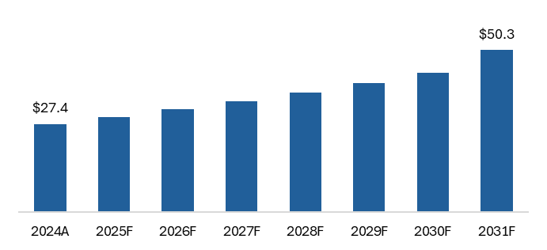
Anesthesia Market Overview
Anesthesia Services Market Overview
U.S. Anesthesia Services Market Size Outlook
The U.S. Anesthesia Services market was valued at $27.4 billion as of 2024, and is expected to grow at a 7.9% CAGR through 2031.
The market is poised for steady growth, underpinned by demographic trends, technological innovation, and the general shift to outpatient care.
While the market faces challenges such as workforce shortages and cost pressures, advancements in drugs, devices, and digital technologies are expected to drive improvements in safety, efficiency, and patient outcomes.
Hospitals remain the dominant end-users, but ASCs are rapidly gaining market share due to the shift towards outpatient care.
($ in billions)
7.9% CAGR
Market Trends
Recent Scientific Developments
Integrating connectivity and data analytics into anesthesia devices enables real-time monitoring of patient vitals and automated adjustments to anesthesia delivery, improving safety and optimizing resource use in clinical settings.
Neuraxial anesthesia stands at the intersection of tradition and transformation.
Practitioners are adopting advanced imaging techniques like ultrasounds and exploring the potential of artificial intelligence, while facing practical concerns like medication shortages and the need for standardization.
The integration of AI into anesthesia workflows is a testament to how technology can support clinicians in making informed decisions quickly and accurately.
XR technologies, including virtual and augmented reality, are remapping anesthesiology training by providing immersive simulations.
In September 2024, Eugia Steriles, a subsidiary of Aurobindo Pharma, received approval for Lidocaine Hydrochloride injection, used as an anesthetic on the body to help reduce discomfort and pain caused by invasive procedures.
In August 2024, Amneal Pharmaceutivals announced FDA approval for its Propofol Injectable Emulsion in three single-dose vial concentrations and it is widely used in hospitals for inducing and maintaining anesthesia and sedation.
In February 2024, Hikma Pharmaceuticals launched Fentanyl Citrate Injection. This medication is designed for short-duration analgesia during anesthesia, premedication, induction, maintenance, and immediate postoperative recovery.
Sources: Signify Research, Rivanna Medical; IBIS World

Slide 33




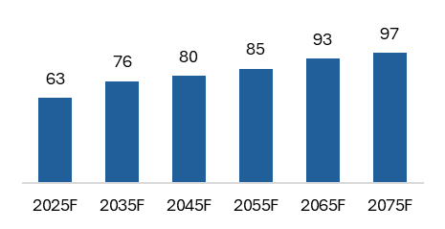
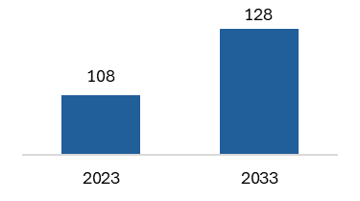
Anesthesia Market Overview (cont’d)
Anesthesia remains an attractive space for investors as compelling characteristics converge to drive market tailwinds.
Services Can Be Performed By Physician or CRNA
Ongoing Proliferation Of Surgeries Performed In
Outpatient Settings
Aging Population Leading To More Chronic Conditions
Services Continue To Be Outsourced By Hospitals
Market Remains Fragmented
Support Positive Outcomes In Value-Based Care Reimbursement Environment
Surgical Procedure Growth
# Americans Over Age 65
Key Industry Stats
(millions)
(millions)
15
Anesthesia organizations that employ at least 500 physicians
3.4% CAGR
22%
US Population over 65 by 2040
60%
Elderly population that will suffer from more than one chronic condition
80%
Hospitals provide stipend payments to their anesthesia provider
Sources: KeyBanc Capital Markets; U.S. Census Bureau; American Society of Anesthesiologists; Kaiser Family Foundation

Slide 34
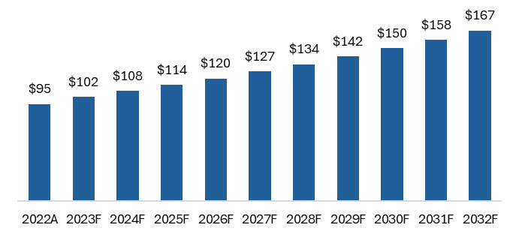
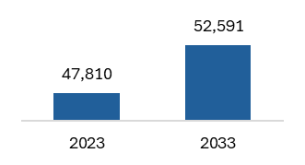
Anesthesia Staffing Market Outlook
The anesthesia staffing market, especially for ambulatory anesthesia, is marked by acute shortages, rising demand, and a need for flexible, innovative staffing solutions to ensure continuity and quality of care.
Market Overview
Ambulatory Anesthesia – In Focus
The U.S. Anesthesia Staffing market is experiencing a critical and worsening shortage of both anesthesiologists and Certified Registered Nurse Anesthetists (“CRNAs”), with up to 78% of facilities reporting shortages as of the end of 2022, up from approximately 35% pre-pandemic.
Projections indicate a shortfall of approximately 6,300 anesthesiologists by 2036, and a 22% workforce shortage across anesthesiology by 2033.
The primary drivers of these shortages include:
  An ageing anesthesia workforce (over half of anesthesiologists are over 55) compounded by increasing retirement rates, particularly accelerated by the COVID-19 pandemic.
  Limited pipeline of new providers due to restricted residency positions.
  Rising demand for surgical and procedural anesthesia, especially as the population ages and seeks more procedures.
The shift towards outpatient and minimally invasive procedures is accelerating demand for anesthesia in ambulatory settings.
Ambulatory Surgical Centers (“ASCs”) are particularly affected by anesthesia staffing shortages, leading to operational challenges and margin compression due to rising labor costs and stagnant payer reimbursement.
ASCs increasingly rely on a mix of employed anesthesiologists, CRNAs, and 1099 providers to maintain coverage.
As the anesthesia staffing shortage persists and worsens, ASCs and other ambulatory providers will need to continue innovating with staffing models, compensation, and operational efficiencies to maintain adequate anesthesia coverage and financial viability.
  Strategic partnerships with staffing agencies, adoption of care team models, and proactive workforce planning will be essential for success in the evolving market.
U.S. ASC Market Size Outlook
In recent years, states have been passing legislation to eliminate the need for direct physician supervision over CRNAs for many procedures, opening a path for greater CRNA growth.
Due to rapid demand of healthcare services and spending, employment of Anesthesiologists and CRNAs is projected to grow faster than the average occupation through 2032.
Projected CRNA Employment Growth in U.S.
($ in billions)
5.7% CAGR
10% Growth
Sources: Medicus Healthcare Research; American Society of Anesthesiologists; Outpatient Surgery Magazine

Slide 35
Anesthesia in the ASC Value-Chain
Anesthesia is a high-value, low-cost component of the ASC value-chain that underpins safety, efficiency, and patient satisfaction in ASC surgical operations.
For common procedures in ambulatory / outpatient settings, anesthesia represents as little as <1% to as much as 20% of the total cost of the procedure, depending on the complexity and type of procedure.
  For example, for a typical lens/cataract surgery, anesthesia represents ~0.7% of the cost, while in something like Carpal Tunnel Release (CTR) surgery, it can represent ~20% of total cost.
The top three procedure types in AAS’s current business mix are (i) Ophthalmologic, (ii) Orthopedic, and (iii) neuromuscular procedures, which represent 23, 18, and 13% of total collections in 2024, respectively.
  In ASC settings, these procedures represent a relatively modest portion (4-15%) of total cost, as outlined in the table below:
Procedure Type | Example Procedure | Anesthesia % of Total Cost (ASC)
Ophthalmologic | Cataract, Vitrectomy (PPV) | 4-10%
Orthopedic | Knee / Shoulder Arthroscopy | 7-15%
Neuromuscular | Carpal Tunnel, Spinal Stim | 2-15%
Sources: Becker’s ASC Review; National Library of Medicine.

Slide 36
Potential Board Members and SMEs
Nicholas Schmidt (schmidtna1@yahoo.com; (954) 560-6525) – Nick is an experienced healthcare executive with a proven track record leading large-scale physician practice platforms, driving operational excellence, and executing growth strategies across multi-state healthcare businesses.
  Chief Operating Officer, OrthoAlliance (2021 – 2023): Expanded PE-backed platform from a single-site practice of 20 physicians to nearly 200 physicians across three states; integrated ASCs and ancillary services; tripled EBITDA during tenure.
  President of New Markets, Unified Women’s Healthcare (2020 – 2021): Led strategy and integration of new-state acquisitions, ensuring operational success and positioning the platform for continued expansion.
  Market COO, MEDNAX (2019 – 2020; prior leadership roles 2003 – 2019): Oversaw ~50 practice sites across a four-state region with $300M+ in revenue; negotiated multimillion-dollar reimbursement increases; built cross-functional teams driving practice integration and physician recruitment.
Nicholas Schmidt ([email];[phone number] – Jeremiah is a seasoned government affairs and business strategy executive with nearly 20 years of experience shaping healthcare, insurance, and public policy initiatives.
  CEO & President, MGS Consultants (2007–Present): Leads a multi-client lobbying and strategy firm specializing in federal appropriations, healthcare regulation, and corporate advocacy
  SVP, Government Affairs – Centria Healthcare (2014–Present): Directs policy and reimbursement strategy for one of the nation’s largest autism therapy providers
  Political Background: Former communications specialist for a U.S. Congressman and legislative aide to the Michigan Senate Majority Floor Leader
  Northern Shore is continuously searching for potential board members and subject matter experts as part of our ongoing diligence and value-creation strategy.

Slide 37
Investment Banking Relationships
Cain Brothers (KeyBanc)
  Patrick Allen, Managing Director (pallen@cainbrothers.com; 312.604.0509)
Brentwood Capital Advisors
  Grey Reames, Vice President (greames@brentwoodcapital.com; 615.425.6493)
Houlihan Lokey
  Austin Smith, Director (ansmith@hl.com; 212.497.4112)
Palm Tree Capital Advisors
  Mitchell Steffens, Vice President (msteffens@palmtreellc.com; 310.636.2050)
TM Capital Advisors
  Josh Mastracci, Managing Director (jmastracci@tmcapital.com; 404.924.4562)

Slide 38
Industry Conferences
American Society of Anesthesiologists – The Anesthesiology Annual Meeting
  October 10 - 14, 2025
  San Antonio, TX
  https://www.asahq.org/annualmeeting
Society for Ambulatory Anesthesia Annual Meeting (SAMBA)
  May 15 - 17, 2025
  Phoenix, AZ
  https://www.sambahq.org/2025-annual-meeting
Ambulatory Surgery Center Association (ASCA) Annual Conference & Expo
  April 30 – May 3, 2025
  Denver, CO
  https://www.ascassociation.org/annualconference/schedule

Slide 39
Financing Update
VI

Slide 40
Financing Update
Northern Shore ran a competitive debt process with multiple lenders. After evaluating term sheets from Gladstone Capital, Five Points Capital, Freeport Financial, and O2 Sponsor Finance, the Company has selected Five Points Capital as the preferred partner, given their attractive economics, diligence completed to-date, and ability to move quickly to closing.
Lender Matrix
 | Five Points Capital (Selected) | Gladstone Capital | Freeport Financial | Old Second (O2) Sponsor Finance
Total Debt $ Amount | Up to $17.0M Term Loan | Up to $24.0M ($17.0M Term Loan + $4.0M Revolver + $3.0M DDTL) | Up to $28.75M total ($14.75M Term Loan + $4.0M Revolver + $10.0M DDTL) | $16.7M total ($14.7M Term Loan + $2.0M Revolver)
Debt / EBITDA | Max 4.1x | Max 4.0x | Max 3.5x | Max 3.5x
Debt Type | Senior secured Term Loan | Senior secured Term Loan + Revolver + DDTL | Senior secured Term Loan + Revolver + DDTL | Senior secured Term Loan + Revolver
Term Loan $ Amount | Up to $17.0M | Up to $17.0M | $14.75M | $14.7M
Pricing | S + 575 (3.00% SOFR floor) | >3.0x: S + 675, ≤3.0x: S + 625 (2.0% SOFR floor) | S + 550 (1.00% SOFR floor) | >4.25x: S + 375 , 2.5≤4.25x: S + 350; ≤2.5x S+325 (1.0% SOFR floor)
Revolver | None | $4.0M Unfunded at close, No borrowing base | $4.0M Unfunded at close, Leverage governed | $2.0M Unfunded at close, Leverage-based
Delayed Draw Term Loan | None | Up to $3.0M, Available for 24 months | Up to $10.0M, Available for 24 months | None
Fees | 1.75% funded term loan fee | 1.75% funded term loan fee; 1.5% revolver commitment fee, 0.5% unused revolver fee; 1.25% DDTL commitment fee, 0.5% unused revolver fee | 2% closing fee, 0.5% unused revolver fee, 1.0% unused DDTL fee, $28.75K annual admin fee | 1% closing fee, 0.5% unused revolver fee, $1K monthly admin fee
Amortization | 1.0% per annum | None Years 1-2; 2.5% per annum Years 3-5 | Term Loan: 1% annually | 5% annually
Maturity | 5 years | 5 years | 5 years | 5 years
Equity Co-Investment | $1.5M | $1.0M - $3.0M | Up to $2.0M (not required) | Not indicated
EBITDA Indication | $4.2M; min of $4.1M at closing | $4.25M; min of $4.2M at closing | $4.2M | $4.25M
Excess Cash Flow Sweep | 50% of excess cash flow if leverage ≥ 2.5x | 50% of excess cash flow if leverage ≥ 2.5x | 50% annually | 50% annually; step-down to 25% if leverage < 2.0x
Prepayment Penalty | 3% Year 1, 2% Year 2, 1% Year 3, 0% thereafter | 2% Year 1, 1% Year 2, 0% thereafter | 2% for first 18 months | None
Financial Covenants | Max Total Leverage not to exceed 3.5x at closing, Min Fixed Charge Coverage | Max Total Leverage not to exceed 4.0x at closing, Min Fixed Charge Coverage | Max Leverage, Min Fixed Charge Coverage, Max CapEx | Min Debt Service Coverage, Max Total Leverage, Max CapEx
Board Observation | Yes | Yes | Not noted | Not noted

Slide 41
Legal Update
VII

Slide 42
Legal Update
Our legal due diligence uncovered that, unintentionally, the Company has been operating in Michigan incorrectly as an LLC, whereas medical practices need to be registered as a PLLC (or PC). The Company’s LLC structure in Indiana is compliant.
As a result, the Company is undergoing a pre-closing restructuring as outlined below to rectify the issue.
The Company has been operating in good faith, with proper licensure and credentials, with the primary purposes of providing anesthesia staffing solutions. As a result, we do not believe there is any regulatory risk and, at any rate, we will be indemnified by the Sellers for any pre-closing liabilities related to this issue. Going forward, we will have an orthodox Corporate Practice of Medicine (“CPOM”) structure in place in full compliance with all regulatory statutes.
Current Operating Structure
Go-Forward Pre-Closing Restructuring
AAS, LLC
AAS, PLLC
Novi AAS, PLLC
West Michigan CRNA, PLLC
MI CRNA, PLLC
Novi AAS, LLC
As part of its pre-closing restructuring, the Company is working with Varnum on:
  Certificate of Conversion and PLLC Articles of Organization
  Certificate of Correct and PLLC Articles of Organization
  Restating Articles of Organization for PLLC
Implications of PLLC Conversion
The tax treatment will remain the same for each entity – preventing any changes in FEIN
Conversion does not trigger any change of control provisions with existing contracts.
Counsel does not anticipate any penalties related to a conversion.
DAG, PLLC
West Michigan CRNA, LLC
MI CRNA, LLC
Detroit Anesthesia Group, LLC
AAS IN, LLC

Slide 43
Post-Closing Legal Structure
The post-closing legal structure will reflect a CPOM-compliant organization. The new management Company will enter into an Asset Purchase Agreement (“APA”) with the practice entity to purchase the non-clinical assets of the PE.
The Management Company and Practice Entity will enter into an Administrative Services Agreement (“ASA”) and Deficit Loan Funding Agreement (“DFLA”); while all entities will enter into a Securities Transfer Restriction Agreement (“STRA”).
This structure allows the management company to effectively exercise full operational control of all non-clinical aspects of the business.
Chris / Mark
Tax Key:
Tax Partnership
NSC
AAS Holdco
Practice Owner
Topco
Disregarded Entity
STRA
Buyer
C-Corporation
AAS MSO
Practice Entity
DFLA
ASA
S-Corporation

Slide 44
Due Diligence Updates
VIII

Slide 45
Key Diligence Issues & Outcomes
Diligence Topic | Description | Status / Resolution | Impact on Investment Thesis | Status
Balance Billing | Collections across the business are at ~95% and AAS is consistently hitting the labor floor in most contracts | All of the collections by ASC are within compliance of the contract specifications; the primary cause of lower-than-expected collections is a result of patient balances. Additionally, management is switching to a new RCM provider (VBRCM) starting in 2026 | Given none of the contracts are explicitly at risk, the opportunity to improve on collections, specifically patient balances, represents upside to our underwriting | Partial
IU Relationship | Collections below 97% of allowables trigger requirement for monthly reports and corrective action plans. Risk of true-up / management fee renegotiation or relationship loss | Confirmed that collections are >98% when removing outstanding patient balances, per contract. | Uncertain, but pending feedback from management and IU Health customer call could be net positive; risk of churn captured in Downside Case | Closed
General Compliance Checklist | Does AAS maintain a formal compliance program (manual, credentialing, verification)? | Engaging third-party (Health Law Partners) to begin creating compliance handbook, targeting completion by close date | Indemnification covers exposure through closing; new compliance program will be in place at-close ensuring no risk borne by NSC | Closed
IU Hand to Shoulder (IUHTS) | The surgeon group running IUHTS left for competing OrthoIndy for better economics, resulting in no staffing from April – May, and 0.3 FTE levels from June - October | IU has backfilled hand and shoulder surgery procedures by diverting ENT procedure flow through to the center; starting 10/27, staffing is expected to rise to full time operations with 1.4 FTE staffed, ramping back to 2.4 FTE by Q1 2026 | Net MOIC impact is minimal at (0.1x), assuming return to normalized staffing in March 2026 | Closed
Ball Outpatient Surgery Center (BOSC) Lawsuit | In the disclosure schedules, a complaint was filed on 10/10/2025 naming BOSC Gina Diaz and AAS Indiana, along with two other staffing providers | AAS is not involved in clinical decision-making during patient care and is indemnified under the 1099 contractor agreement; | None – AAS is not expected to be named in further proceedings, and NSC has received a specific indemnity for the claim | Closed

Slide 46
Key Diligence Issues & Outcomes
Diligence Topic | Description | Status / Resolution | Impact on Investment Thesis | Status
MIP Plan | Current allocation of the MIP may be too high, limiting capacity to reserve equity for future critical hires (e.g., CFO, senior leadership) | After back and forth, management has landed on allocation of only 16% of the MIP, leaving significant room for future hires | With 16% allocated today, we have room to provide more equity to attract certain key hires, i.e., CFO | Closed
Solaris Health Acquisition | Cardinal Health acquired Solaris; potential concern whether acquisition drives contract changes | Contracts remain independent; aggregator ownership does not typically trigger wholesale vendor changes especially in new markets | Model assumes Solaris contracts churn at renewal. Extension would be upside, adding 0.5x MOIC | Closed
Hospital-Owned ASC Viability | Hospital-Owned ASCs (e.g., IU Health) may not be ideal long-term partners given risk of insourcing anesthesia | Providers typically prefer either ASC or hospital settings, limiting cross-coverage potential. ASC scheduling needs vary widely and require a deep bench of providers, making insourcing cost-prohibitive for hospitals | Supports thesis that staffing remains outsourced across ownership models. Underwriting does not rely on hospital system wins given prevalence of indep. and mgmt co.-owned ASCs | Closed
1099 to W2 Conversion | ~40 AAS employees were non-compliantly classified as 1099 and must be converted to W2 pre-closing | Conversion is complete, with all prior full-time 1099 providers converted to W2 | Net impact is a $54K benefit to the Company as of latest modeling | Closed
Anesthesia Staffing Market Perception | Risk that ASCs view anesthesia groups as temporary staffing stop gaps | Research (Chartis, management meetings, expert calls) suggest this is not the case – groups are viewed as strategic partners where exclusivity is contractual | Supports durability of ASC relationships and validates thesis | Closed

Slide 47
Key Diligence Issues & Outcomes (Cont’d)
Diligence Topic | Description | Status / Resolution | Impact on Investment Thesis | Status
SCA / IU JV | Could there be potential risk in center loss if SCA or IU were to acquire 100% of the JV centers outright? | There are no change-of-control provisions in any of the contracts for IU / SCA centers, and the contracts are directly with the center themselves | No incremental impact to thesis, confirms that centers are sticky customers with contractual obligations | Closed
New ASC Delay | American Pain Consortium (5.2 FTE across 4 centers) and Westfield Surgery Center (5 FTE) have been delayed to November and December starts from October and August, respectively | Westfield has been delayed due to flooding damage during renovations and is purely a timing delay; APC is waiting for the head of operations to return from maternity leave and provide a start date | Both delays impact 2025 performance but should not have any impact on 2026 revenue or Gross Profit | Closed

Slide 48
Material Legal Points
Document | Point | Proposal | Counter #1 | Counter #2 | Counter #3 | Closed / Open
Purchase Agreement | Definition of Growth Capital | Sellers proposed that growth capital exclude management fees and interest payments | NSC included language that growth capital is intended to be used for general corporate growth and that it is not intended to be used for management fees (struck interest payments) | NA |  | Closed
Purchase Agreement | Earnout | NSC proposed 85% of earnout targets as a minimum threshold for participation | Sellers viewed 85% as a threshold for catch up | NSC countered with 20% floor at 85% of target or 95% floor at 95% of target | Sellers re-countered at 25% floor at 85% of target | Closed
Employment Agreement | Salary | NSC proposed keeping salaries consistent with QofE adjustment at $200K and $150K |  |  |  | Closed
Employment Agreement | Bonus | Sellers proposed NSC include some bonus amount | NSC included 50% bonus targets |  |  | Closed
Employment Agreement | Vacation | NSC proposed 4 weeks of vacation | Sellers countered with 10 weeks | NSC responded with 6 weeks, sellers proposed 8 | NSC resolved with unlimited PTO | Closed
Employment Agreement | Non-Compete | NSC proposed 2 year non-compete with geographic scope of entire U.S. | Sellers countered with 1 year and 20-mile radius | NSC responded with 2 years and all states where the Company provides services | Sellers agreed to 2 years, and 75-mile radius | Closed
Employment Agreement | Shift Compensation | Sellers proposed payment for shifts performed | NSC pushed back with no shift compensation (required to pay min. wage) |  |  | Closed
Credit Agreement | Covenants | NSC proposed 35%+ cushion (see next page) | Lenders agreed with covenants but proposed max leverage at 4.5x vs 5.0x out of the gate |  |  | Closed

Slide 49
Covenant Proposal
2025 – 2028 Leverage Covenants

Slide 50
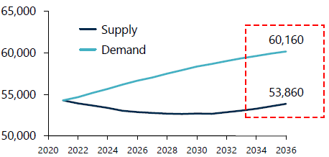
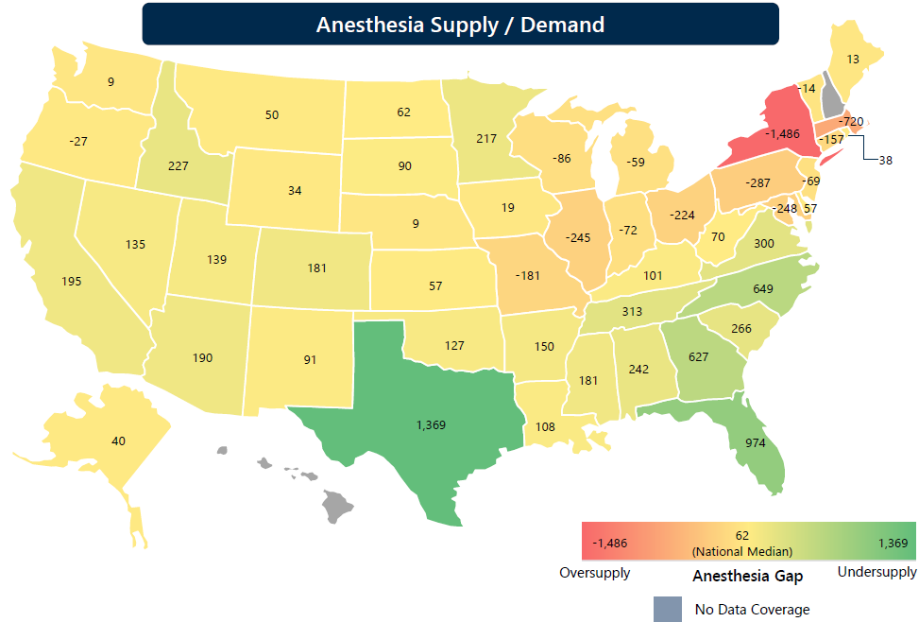
Growing Anesthesiologist Shortage
AAS is well-positioned to maintain / take share of MDA supply given exceptional culture and above market (~60-65 percentile) pay
Projected U.S. MDA Supply/Demand Imbalance
Market Drivers
The U.S. Anesthesia market is forecasted to reach a shortage of ~6,300 anesthesiologists by 2036, primarily driven by:
  Surgical Demand: surgical services are expected to continue growing at 2-3% p.a. over the next decade
  Provider Burnout: nearly half of anesthesiologists report burnout, with 61% open to reducing pay for improved work-life balance
  Top-of-Funnel Limitations: In 2024, only 1,695 positions were available for anesthesia residency
  Aging Workforce: 38% of anesthesiologists are 55 or older, and the cohort of 65+ providers is projected to grow 30% by 2035
2025 State-Level Staffing Shortage
Market Drivers
There is a shortage of ~3,000 anesthesiologists nationwide, with Texas, Florida, North Carolina, and Georgia exhibiting the largest supply shortage
Physician staffing demand relative to need is appropriately aligned in Indiana and Michigan, with Ohio and Illinois showing a slight oversupply
Within Midwest states, Minnesota has growing physician supply shortages relative to need
The Southeast region has growing demand needs. Aligned with a potential AAS playbook to enter new markets, the Southeast may be suitable given growing imbalance
Sources: Chartis Market Study

Slide 51
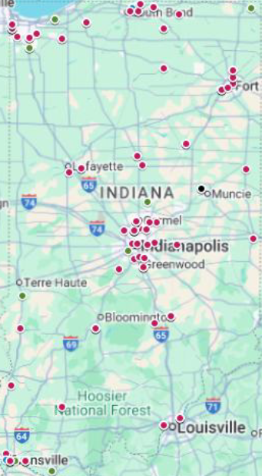
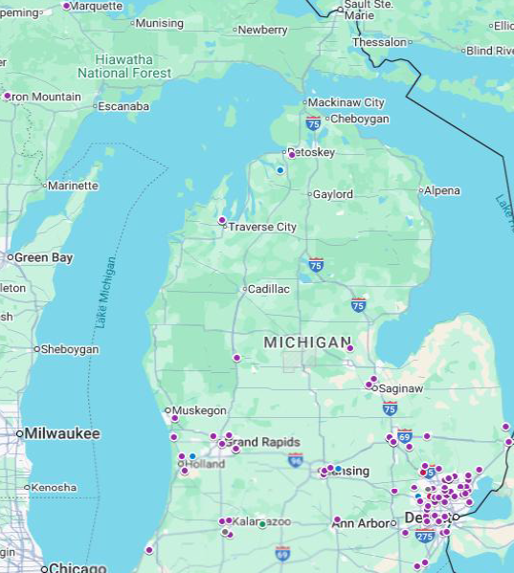
ASC Expansion in Existing States
Indiana ASC Landscape
Michigan ASC Landscape
Significant Runway Exists to Increase Density in AAS Existing Markets
While West Michigan Presents Opportunity to Expand Michigan Footprint
USPI Represents an Attractive Partnership Opportunity for AAS
Implications for AAS
Key Commentary
AAS already has a foothold in Indianapolis and Fort Wayne – adding density would enhance staffing efficiency
USPI is a dominant player making system-wide partnership a potential if AAS can land and expand, however the market remains fragmented with 124 ASCs without a management company
West Michigan is less consolidated than Metro Detroit and represents a potential expansion opportunity, as Corewell Health recently transitioned away from its prior anesthesia partner and is currently relying on Locums for interim coverage
Sources: Chartis Market Study

Slide 52
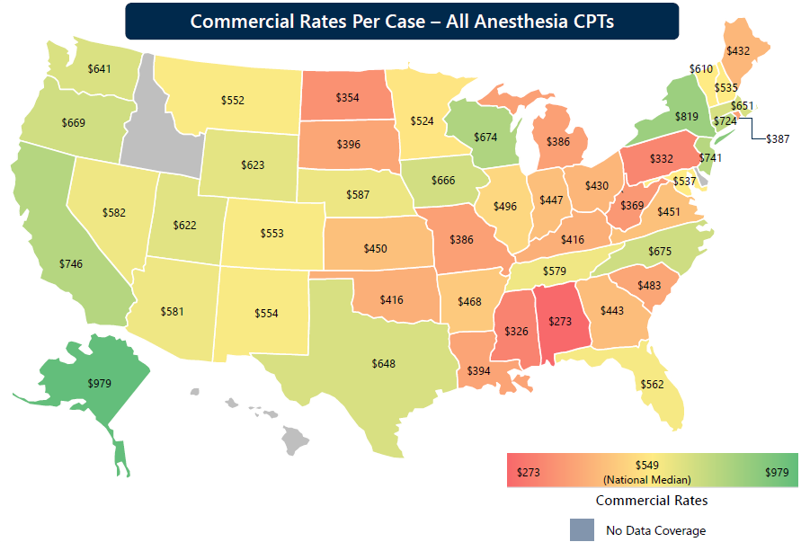
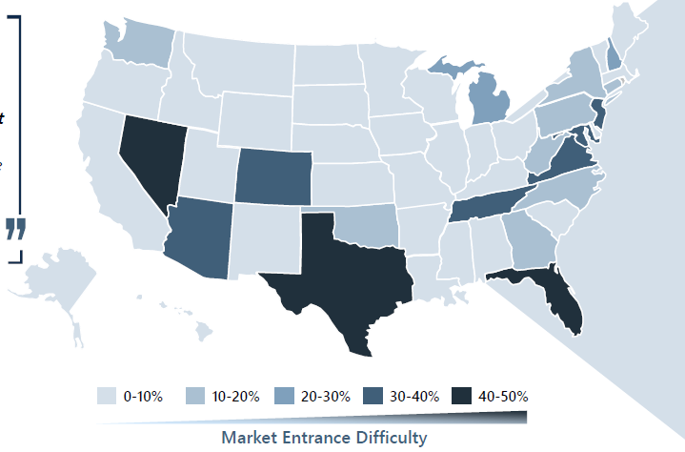
New Geography Expansion Scorecard
Leveraging Chartis data, California and Oregon represent the most attractive expansion states, based on equal weighting of commercial reimbursement rates, market entrance difficulty, and a minimum of 50 ASCs per state
New ASC Market Opportunity
Commercial Reimbursement Rates by State
Anesthesia Consolidator Market Share by State
Represents top 10 most attractive states, calculated by equal weighting to reimbursement rate and difficulty to enter market (min 50 ASC in given state)
Sources: Chartis Market Study

Slide 53
New Geography Expansion Scorecard (Cont’d)
Key Considerations
The scope of the new geography scorecard was limited to only 2 variables – reimbursement rates and market saturation of existing consolidators. Relevant follow-on considerations include:
  Minimum ASCs: The previous analysis screened for states with at least 50 ASCs, however distribution within a state likely is more important than raw count as distribution may be uneven across individual markets. Expansion is most viable where there is a meaningful cluster within driving distance for provider scheduling efficiency
  Regulatory Dynamics: Licensing requirements, CRNA supervision requirements, and anesthesia scope of practice rules all vary by state. States that restrict Independent CRNA practice, for example, generally drive higher staffing costs and reduce flexibility
  Payor Concentration: States where 1-3 payors dominate commercial market share introduces leverage against anesthesia providers, limiting reimbursement upside and increasing contract concentration risk
  Anesthesia Supply / Demand: Provider shortages may present unique opportunities for entry, but may also introduce escalated staffing costs and potential coverage unreliability. States with deeper anesthesia pools may be more structurally favorable
  Certificate of Need (“CON”) Laws for ASC development: CON requirements restrict new ASC development, making growth reliant on acquiring existing centers and stealing share. Non-CON states support more robust de novo growth opportunities
Sources: Chartis Market Study

Slide 54
ConnectTeam Staffing Levels
April 2025 – September 2025 Monthly Staffing
Commentary:
  East Washington & South are experiencing temporary declines in nursing and ancillary staff at the facility level
  EEC 12 Mile had an Endo surgeon out on medical leave but has since returned
  IU HTS has returned to stabilized levels of 1.4 FTE starting 10/27/2025

Slide 55
Reimbursement Data vs Chartis
Michigan Reimbursement
Indiana Reimbursement
Michigan reimbursement rates are on par with the Chartis data, while Indiana shows significant room for growth

Slide 56
Key Value Creation Pillars
Key Pillars
Key Levers
Ex. Metrics & Tactics
Mitigate Contract Churn
Strengthen partner satisfaction and create structure around relationship management
Improve collection performance to reduce ASC subsidies
Maintain reliable, high-quality staffing coverage
Administer center satisfaction scorecard
Implement account management strategy
Track monthly subsidizing coverage by center
Track provider retention and on-time coverage rate
1
Grow ASC Portfolio
Improved top-of-funnel activity (increased RFPs and referrals)
Improved conversion from RFP to signed contract
Expanding into new markets
Partnering with management companies as they build and acquire new ASCs
Examine pipeline tracking process and determine if it a CRM is needed
Create incentive structure for ASC referrals by providers
Create scorecard for new market attractiveness
2
Expand Margin Profile
Improve RCM performance collections above labor floor
Optimize contract pricing and structure (i.e., true-ups) to capture upside
Drive density in existing and new markets, achieving sufficient scale to negotiate favorable rates with payors
Expand into higher reimbursement rate states with favorable payor mixes
Track Gross Margin by ASC
Track % contracts above floor
Calculate weighted average reimbursement rate by payor
3

Slide 57
Historical Centers Added and Lost
AAS has experienced rapid growth, adding 1 new ASC per year in 2020 and 2021, to 7 new ASCs added in 2025 alone
ASC Rollforward
Note: 2025 adds exclude the 4 APC centers as the start date is not yet confirmed; also excludes Atlas (Livonia) which is a 2026 start

Slide 58
Competitive Landscape
Indiana
Company | Locations Served | # of Clinicians (Est.) | Client Type / Notable Clients | Ownership
Anesthesia Services for Indiana | Indiana | <100 | N/A | Physician-owned
Indiana Anesthesia Solutions | Indiana | <100 | Hospitals and ASCs | Physician-owned
Lakeshore Anesthesia | Northern Indiana | 30+ | Hospitals and ASCs / Powers Health, Lutheran affiliates | Physician-owned
Northside Anesthesia Services | Indiana | 100+ | Hospitals and ASCs / Ascension St. Vincent affiliates | Physician-owned
NorthStar Anesthesia | National, including Indiana | 4,000+ | Hospitals and ASCs / Baptist Health and Franciscan affiliates | The Cranemere Group
US Anesthesia Partners | National, including Indiana | 5,000+ | Hospitals and ASCs / Lutheran and Parkview affiliates | Welsh Carson Anderson & Stowe
Windy City Anesthesia | IN, IL, WI, IA, NE, MO, MI, FL | <100 | ASCs and office-based | Physician-owned
 |  | Michigan
Company | Locations Served | # of Clinicians (Est.) | Client Type / Notable Clients | Ownership
Anesthesia Associates of Ann Arbor | Michigan & Ohio | 100+ | Hospitals and ASCs / Mclaren & Trinity Health | Siromed / Prospect Hill Growth Partners
Anesthesia Management Services | Metro Detroit | 200+ | Hospitals and ASCs / Mclaren and Henry Ford | Physician-owned
Anesthesia Practice Consultants | Western Michigan | 200+ | Hospitals and ASCs | Physician-owned
NorthStar Anesthesia | National, including Michigan | 4,000+ | Hospitals and ASCs / Baptist Health and Franciscan affiliates | The Cranemere Group
Radius Anesthesia of Michigan | Michigan | 200+ | ASCs and office-based | Physician-owned
Sources: Chartis Market Study

Slide 59
Expert Call Transcripts
Relevant Quotes
Former Tenet Healthcare Competitor Thinks Ambulatory Surgery Centers Tend to Outsource – 08/19/2024
  Q: “What about the ambulatory surgery centers? Are they more likely to outsource or to have their people in-house, especially given the fact that they tend to have very consistent hours?”
  A: “I hate to use that term, but they're the kings of outsourcing. The outsourcing started with the ambulatory surgery centers. Because they function in a manner that may be very limited, so they bring in people when they need them. That makes sense to them.”
Former CIO of U.S. Anesthesia Partners Thinks the Industry’s Facing a Coming Shortage of Anesthesiologists – 05/11/2023
  Q: “Why is anesthesiology different? For instance, if you're a hospital, you have the capability to hire doctors, nurses, orderlies, technicians, radiologists, janitors, receptionists. Hospitals hire a wide variety of people with a wide variety of skills and they do that themselves. Why is anesthesiology different? Why do the hospitals have difficulty doing this themselves and why are they going to an outside agency instead of staffing up themselves?”
  A: “Yeah. Staffing up themselves is one option, but I think the hospitals that have tried that have gotten themselves into trouble in a couple of areas. One, it's just having the right number of staff and people that are available to cover the different OR rooms. For a health system, the OR is the most profitable area, that's where they make the most money, and having staff anesthesiologists to cover those, because obviously you can't perform in OR if you don't have them, and what I've come to realize is, over my last couple of years, how important the anesthesiologist is to the surgery…”
  “Basically, if you staff your hospital for max capacity OR, you got a lot of anesthesiologists sitting around doing nothing. If you staff for minimum, you have everyone else who can't do their job. Basically, the issue isn't that the hospitals can't do it. It's that demand fluctuates so wildly that it's difficult to have that particular group of people on staff full-time.”
Sources: AlphaSense Expert Call Transcripts

Slide 60
IT Diligence / Technology Stack
System Name | Category | Description | How Is It Being Used? | What Data Is Being Stored? | HIPAA Compliant?
Office 365/Google Suite | Software Subscription | Used for company email, document collaboration, and basic productivity tools | Company uses Microsoft Suite (Outlook, Excel, etc.) | N/A - Azure cloud managed by Hyperion | Yes
Paychex | Payroll Service | Manages payroll processing across all entities | Payroll | Employee information, SSN, DOB, Address, etc. | N/A
Connecteam | Surgical Scheduling Software | ASC/provider scheduling | Scheduling providers | Same as Paychex + credentialing | Yes
Google Analytics | Analytics - Marketing | Operated through Basso | Marketing | Stored with Basso | N/A
Physicians Choice | Billing & Collection Partnership | Provides outsourced RCM, credentialing, etc. | Billing & Collections | Patient data (e.g., address, MRN, etc.) and procedure information, ASC information, provider information, etc. | Yes
Hyperion Managed Services | MSP | Provides ongoing, outsourced IT services | N/A | N/A - Azure cloud managed by Hyperion | Yes
QuickBooks | Overseen by Hosmer CPAs | Financial reporting | Financial reporting | Financial information | N/A

Slide 61
AAS Hiring & HR Process
Amy Elliott conducted a detailed review of AAS’s broader hiring and HR processes, identifying current practices, system gaps, and opportunities for improvement.
Clinician Hiring & Onboarding: Leads sourced via referral, social media, and job postings → initial screening by leadership, followed by contract issuance → credentialing handled via Connecteam → ASC clearance requires 1–3 months → payroll setup completed post-credentialing.
Compliance & Credential Tracking: Connecteam used for document storage and tracking, however no background checks are performed currently, only license verification.
Staffing & PRN Utilization:
  PRN staff flexes up/down to meet ASC demand; flexing down is favored for retention
  Connecteam provides real-time visibility of cleared PRN availability for each ASC
Termination Process:
  AAS has no involuntary terminations; voluntary staff are shifted to other ASCs
  Employees are either made PRN or inactive if no longer interested in working. There are look-backs for staff that have not worked in the last 6 months, but this is inconsistently performed
Marketing & Social Media: AAS utilizes “Basso” to manage their website, 4 social media posts per week, key searches and analytics.
System Limitations:
  Connecteam does not differentiate 1099 vs W2 and would require additional cost to acquire those features
  Connecteam does not have an Applicant Tracking System (“ATS”) to support candidate pipeline management
  Connecteam costs are incurred per active user
Recommendations:
  Review Basso contract for potential savings and expanded digital outreach (email campaigns, candidate sourcing)
  Implement an ATS to build candidate pipelines and track hires
  Enhance Connecteam functionality (status tracking, user categorization)
  Invest in back-office team, role clarity, and specialization
  Add HR/recruiter roles to support scaling
  Ensure full compliance on background checks and credentialing under W2 models

Slide 62
Supply / Demand
Michigan
Supply (State-Level)
Active Licensed CRNAs 2025: 2,960
1,692 active licensed Medical Doctor Anesthesiologists
Demand (Detroit)
MDA
  40+ Anesthesiologist active job postings
  Full-time positions make up about 64% of the postings.
  Part-time positions account for around 12%.
  PRN/contingent or locum tenens roles constitute roughly 24%.
CRNA
  100+ unique active postings
  Full-time positions constitute roughly 55% of the postings.
  Part-time positions account for about 20%
  PRN/contingent or locum tenens roles represent around 25%
Indiana
Supply (State-Level)
Active Licensed CRNAs 2025: 1,300
920 active licensed Medical Doctor Anesthesiologists
Demand (Detroit)
MDA
  50+Anesthesiologist active job postings
  Full-time positions make up about 68% of the postings.
  Part-time positions account for around 12%.
  PRN/contingent or locum tenens roles constitute roughly 20%.
CRNA
  40+ CRNA active job postings
  Full-time positions constitute roughly 60% of the postings.
  Part-time positions account for about 15%.
  PRN/contingent or locum tenens roles represent around 25%.
Sources: MI American Association of Nurse Anesthesiology, Nurse.org, Indeed, Zip Recruiter, Doc Cafe

Slide 63
Market Compensation vs AAS
AAS Pay Versus Local Markets
AAS Consistently Pays At Or Above Market Compensation for Both CRNA and MDAs
Sources: Nurse.org, Indeed, Zip Recruiter, Doc Cafe

Slide 64
Market Compensation
Detroit
MDA
CRNA
Role | City | Percentile | Salary Est. | Notes
MDA | Detroit | 25th | $413K | Early-career in community hospitals or general roles (e.g, NorthStar)
MDA | Detroit | 50th | $441K | Mid-career standard; aligns with Salary.com average for subspecialty roles
MDA | Detroit | 75th | $479K | Experienced in high-acuity settings or locums
Role | City | Percentile | Salary Est. | Notes
CRNA | Detroit | 25th | $229K | Entry-level or outpatient roles (e.g., general anesthesia at community clinics)
CRNA | Detroit | 50th | $242K | Mid-career standard; aligns with Salary.com average for hospital roles
CRNA | Detroit | 75th | $275K | Experienced CRNAs in high-demand settings (e.g. trauma / OB)
Indianapolis
MDA
CRNA
Role | City | Percentile | Salary Est. | Notes
MDA | Indianapolis | 25th | $345K | Early-career in general or outpatient roles
MDA | Indianapolis | 50th | $390K | Mid-career in academic or hospital settings; matches Salary.com average
MDA | Indianapolis | 75th | $420K | Experienced in subspecialties or locums at IU Health
Role | City | Percentile | Salary Est. | Notes
CRNA | Indianapolis | 25th | $202K | Newer CRNAs in outpatient or less complex settings
CRNA | Indianapolis | 50th | $236K | Mid-career in hospital systems; matches Salary.com average
CRNA | Indianapolis | 75th | $234K | Experienced in academic centers or locums
Sources: MI American Association of Nurse Anesthesiology, Nurse.org, Indeed, Zip Recruiter, Doc Cafe

Slide 65
Prevalence of W2 Versus 1099 Job Postings
As of September 24, 2025, exact counts of active job postings specifying W2 (employee with benefits) vs 1099 (independent contractor/locums) remain challenging to pinpoint, as many listings imply but do not explicitly state the classification, however we have summarized key insights based on the postings that were found.
Key Insights
City Comparison: Detroit has a higher W2:1099 ratio (~1.9:1 average) than Indianapolis (~1.5:1), reflecting Detroit's emphasis on employed models in high-volume hospitals amid trauma demand. Indianapolis postings are more balanced, with 1099 growth (~15–20% YoY) for locums in OB/ortho at surgery centers.
Role Comparison: CRNAs show a stronger W2 skew (1.75:1 average) than Anesthesiologists (1.65:1), as CRNAs often integrate into ACT teams with benefits. Anesthesiologists have more 1099 for short-term subspecialty needs (e.g., no-call locums).
Key Trends: 1099 postings are up ~20% YoY nationally per AANA, driven by flexibility, but W2 dominates (55–70%) for benefits like malpractice and PTO. Unspecified listings (~35%) likely W2 in large systems. Premiums for 1099: $20–$50/hr. more, but self-managed taxes/insurance.
Limitations: Estimates from ~20–50 listings per category; duplicates reduce the unique by 20%. For precision, we filtered Indeed ("W2" or "1099").

Slide 66
CFO Search Process (As of 10/26/25)
Amy Elliott has led the CFO search process on behalf of AAS, utilizing both public job postings on LinkedIn, as well as proactive outreach to qualified candidates across the PE-backed physician practice management landscape. The job posting results have naturally been much quicker to yield results, however the quality of applicants has been far below the direct sourcing method.
Job Posting
Direct Sourcing
346
Applications
190
Prospects
25
Phone Screens
20
Phone Screens
2.3%
Applicant-to-Case Study Conversion Rate
3.7%
Prospect-to-Case Study Conversion Rate¹
14
1st Round
Calls
15
1st Round
Calls
8
Case Studies
7
Case Studies¹
3
Final Round Interviews
TBD
Final Round Interviews
1. One candidate dropped out of the process due to receiving a competing offer

Slide 67
Confidential

Slide 68
Legal Due Diligence
Mayer Brown is in process of conducting full legal due diligence. We will provide further updates upon receipt of Mayer Brown’s report.

Slide 69
Background Checks
Northern Shore is currently awaiting the results of detailed background checks from Corporate Resolutions. We will provide further updates in the near future.

Slide 70
Customer Calls
NSC is planning to conduct customer calls prior to closing, including major customers (e.g., IU Health).

